Slide 1
Lab 6: A Binomial Experiment
STAT 201: Elementary Statistics
Pre -lab

Slide 2
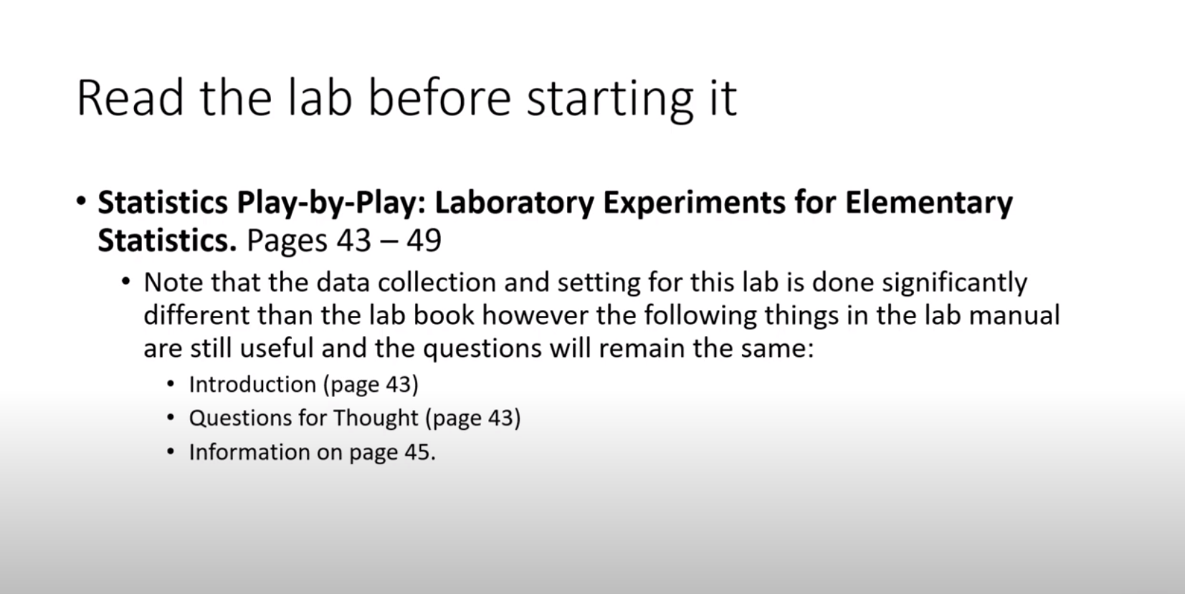

Slide 3
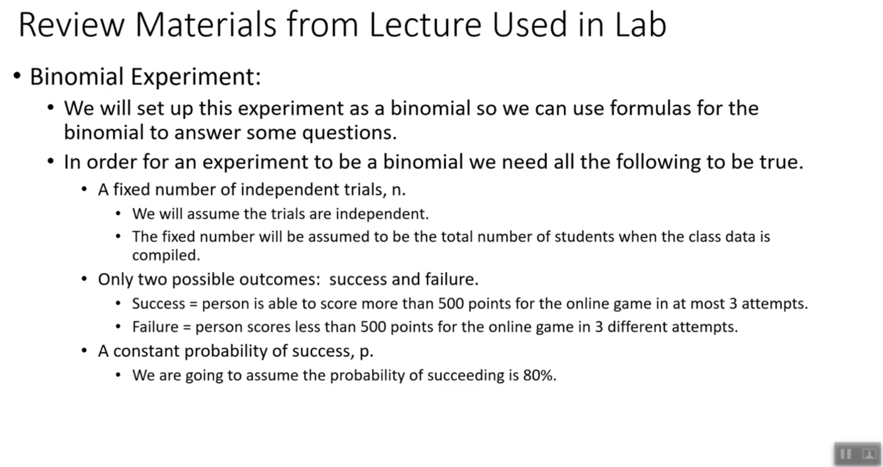

Slide 4
Concepts for this Lab : Binomial
If binary data (exactly 2 outcomes) then the binomial experiment might be appropriate.

Slide 5
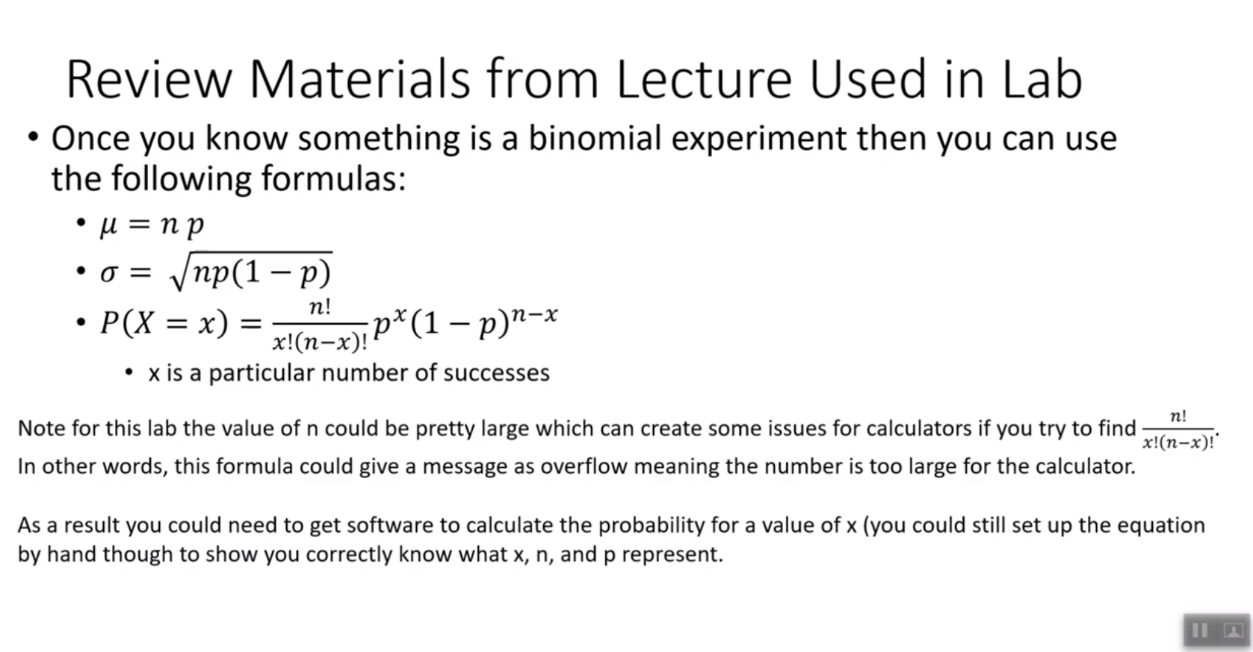

Slide 6
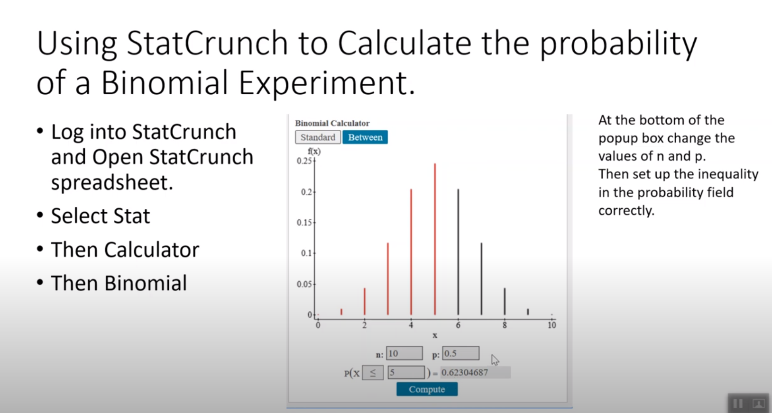

Slide 7
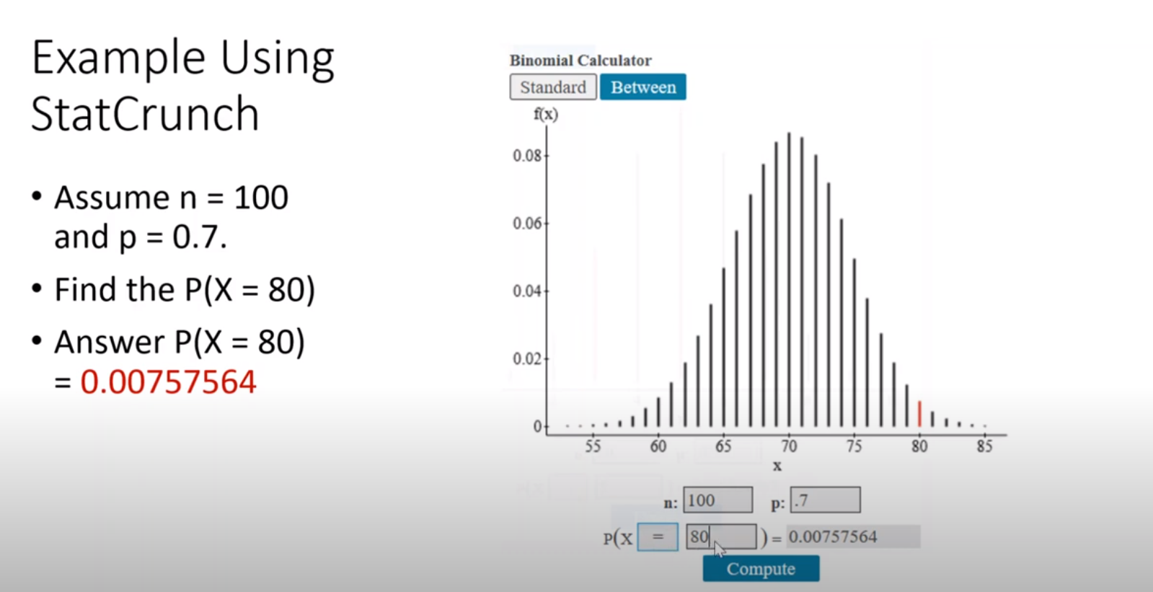

Slide 8
